Slide 1
Three Seas Initiative involves 13
European Union states
Baltic Sea
Austria
Bulgaria
Croatia
Czechia
Estonia
Greece
Hungary
Latvia
Lithuania
Poland
Romania
Slovakia
Slovenia
Black Sea
Adriatic Sea
All states, except Austria, are NATO members.

Slide 2
Three Seas Initative aims
Three Seas Initiative is a regional cooperation format involving thirteen European Union states. It aims is to expand infrastructure on the north-south axis and develop economic cooperation in the Central Europe in three areas:
TRANSPORT
ENERGY
DIGITALIZATION

Slide 3
Three Seas Iniative aims
CENTRAL EUROPE
EUROPEAN UNION
UNITED STATES
Economic development of Central Europe - the eastern part of the EU
Strengthening the cohesion of the European Union and its potential
Strengthening transatlantic relations

Slide 4
Selected statistical data on the Three Seas Initiative states
the states of the Three Seas Initiative represent 32% of the EU area, 27% of the population and only 16% of GDP;
Source: Eurostat/ data consistent with the fourth quarter of 2023
Data processing: Dr. Konrad Popławski

Slide 5
Organizational formula
From the organizational side, the Three Seas Initiative is based on annual summits (summit diplomacy), where joint declarations are adopted. The summits are convened by the presidents of the subsequent states organizing the event;
The Three Seas Initiative is a flexible presidential forum that provides political platform to support more effective cooperation between governments, economic actors and non-governmental organizations interested in strengthening regional ties;
The cooperation focuses on the implementation of projects developing connections between states;
Participation based on EU membership;
The project is complementary to the EU and is intended to strengthen its sustainable development;
The Three Seas Initiative is not an international organization. There is no statute, headquarters, secretariat or permanent institutional structures;
Definicja

Slide 6
Origins of the Three Seas Initiative
Striving to accelerate the economic development of the eastern part of the European Union, with emphasis on the development of infrastructure connecting the north with the south; common interests of the states of the region;
“Let me give you a practical example of the infrastructure gap in the region: you know that the Danube River is the natural border between Bulgaria and Romania, our northern neighbor. On the 700 km long border, there are only two bridges connecting us: on Ruse-Giurgiu and on Vidyń-Calafat.”
Ambassador of Bulgaria to Poland Emil Savov Yalnazov, 2019
Source: A. Orzelska-Stączek, P. Ukielski, Three Seas Initiative from the perspective of its participants, Warsaw 2020

Slide 7
Origins of the Three Seas Initiative
Cracow
8 IX 2015
New York
29 IX 2015
Meeting of the presidents of Poland, Andrzej Duda, and Croatia, Kolinda Grabar Kitarović: discussion on building a community of states between the Baltic, Adriatic and Black Sea.
Informal meeting of representatives of 12 Central European states on the occasion of the 70th session of the UN General Assembly; the decision was made to organize an official summit in Dubrovnik.

Slide 8
Three Seas Initative summits
I. Three Seas Initative summit Dubrovnik 24-25 VIII 2016
II. Three Seas Initative summit Warsaw 6-7 VI 2017
III. Three Seas Initative summit Bucharest 17-18 IX 2018
IV. Three Seas Initative summit Ljubljana 5-6 VI 2019
V. Three Seas Initative summit Tallinn 19-20 X 2020
VI. Three Seas Initative summit Sofia 8-9 VII 2021
VII. Three Seas Initative summit Riga 20-21 VI 2022
VIII. Three Seas Initative summit Bucharest 7-8 IX 2023
IX. Three Seas Initative summit Vilnius 11 IV 2024

Slide 9
Three Seas Initiative key decisions
Summit number
Host
Date
Key decisions and effects of the summit
declaration from the Dubrovnik summit: the goal of the Three Seas Initiative is to develop cooperation in the area of transport, digital and energy infrastructure;
defining the Three Seas Initiative as an informal presidential platform;
I
24-25 VIII 2016
the US president, as a special guest of the summit, declares support for the Three Seas Initiative;
in the declaration states emphasize that their cooperation is intended to strengthen a coherent and strong European Union;
II
2-7 VI 2017

Slide 10
Three Seas Initiative key decisions
Summit number
Host
Date
Key decisions and effects of the summit
the three fundamental pillars and goals of the Three Seas Initiative are: strengthening economic development, increasing EU cohesion and enriching transatlantic ties;
creation of a category of partner countries: USA and Germany and partner institutions: European Commission EU, EIB, EBRD, World Bank Group;
presentation of the List of Priority Interconnection Projects;
first edition of the Business Forum, 3SI Business Forum;
signing a letter of intent regarding the establishment of the Three Seas Initiative Investment Fund;
III
17-18 IX 2018

Slide 11
Three Seas Initiative key decisions
Summit number
Host
Date
Key decisions and effects of the summit
emphasizing that the Three Seas Initiative remains fully consistent with EU efforts to strengthen cohesion and overcome regional disparities in the EU;
recognizing the US economic presence in the Three Seas region as a step towards strengthening transatlantic ties;
IV
5-6 VI 2019
summit in the hybrid formula;
extending cooperation beyond the presidential format - ministerial session;
V
19-20 X 2020

Slide 12
Three Seas Initiative key decisions
Summit number
Host
Date
Key decisions and effects of the summit
emphasizing that the Three Seas Initiative is a platform for cooperation in the areas of transport, energy and digitalization, strengthening EU cohesion;
emphasizing the significant potential of the Three Seas Initiative Investment Fund as an important co-financing mechanism for closing the infrastructure gap in the region;
VI
8-9 VII 2021

Slide 13
Three Seas Initiative key decisions
Summit number
Host
Date
Key decisions and effects of the summit
declaration of the US agency, DFC (International Development Finance Corporation) about its involvement in the Three Seas Initiative Investment Fund of USD 300 million;
organizing the Civil Forum, 3SI Civil Society Forum (20-21 May);
VII
20-21 VI 2022

Slide 14
Three Seas Initiative key decisions
Summit number
Host
Date
Key decisions and effects of the summit
Greece became a new participating state of the Three Seas Initiative;
Moldova became a 3SI associated participating state together with Ukraine;
On the initiative of Poland, Bulgaria, Lithuania and Romania, a decision was made to establish the Three Seas Business Development Association (TSBDA) based in Brussels;
Organization of a scientific panel for the first time during the 3SI Business Forum by the Three Seas Initiative Research Center at the Institute of Political Studies of the Polish Academy of Sciences and the Romanian think-tank New Strategy Center;
VIII
7-8 IX 2023

Slide 15
Three Seas Initiative key decisions
Summit number
Host
Date
Key decisions and effects of the summit
Japan became a strategic partner;
Signing a letter of intent regarding the establishment of the second Three Seas Initiative Investment Fund;
Announcement of the creation of the 3SI Innovation Fund in cooperation with the European Investment Fund;
Ukraine and Moldova contributed to the List of Priority Interconnection Projects;
One of the accompanying events was the first scientific conference organized by the Three Seas Initiative Research Center at the ISP PAN in cooperation with the Lithuanian Academy of Sciences and the University of Lodz;
IX
11 IV 2024

Slide 16
Results
A formula of cooperation will be created, in which summits of the presidents of the Three Seas Initiative countries have been regularly organized since 2016.
Introduction to the discourse of the terms: Three Seas Initiative, Three Seas, Three Seas region.
Extending the cooperation of the Three Seas Initiative to include meetings in the following formats: business and local government; Building cooperation at the level of think-tanks and research centers in the region.
Development of the Three Seas Initiative Investment Fund
Creating the List of Priority Interconnection Projects

Slide 17
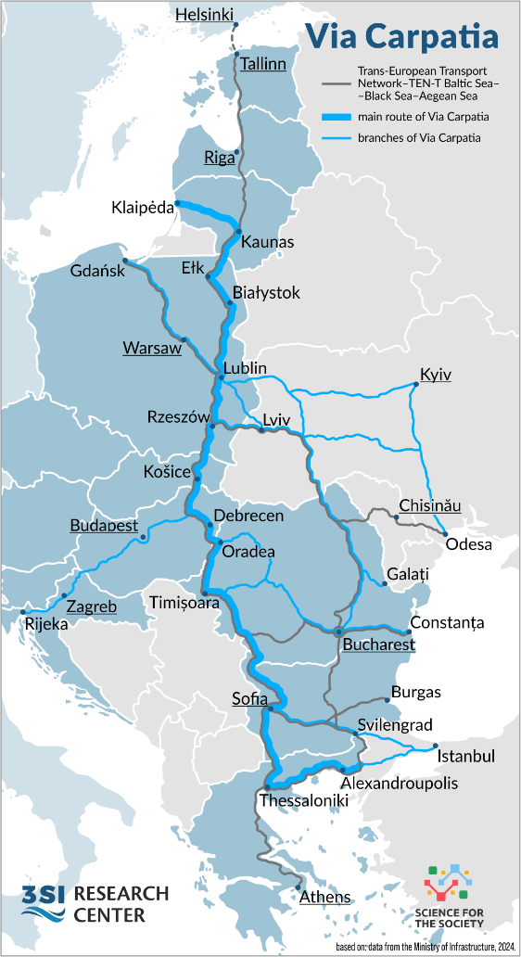
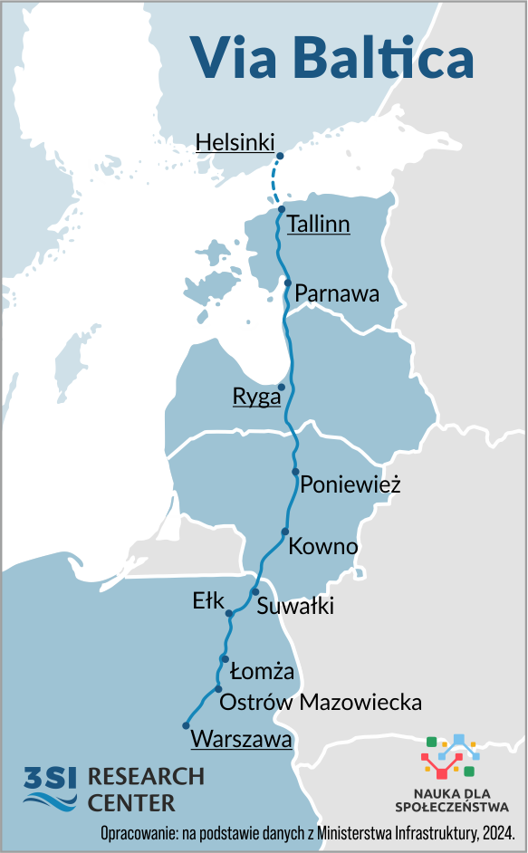
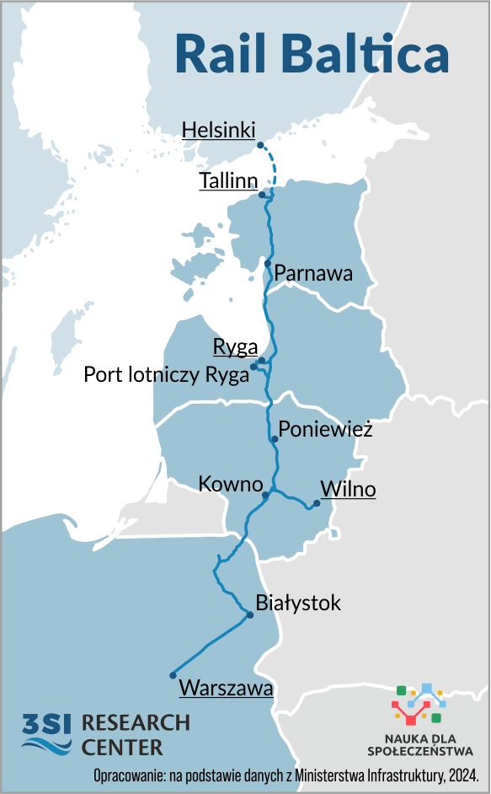
Examples of infrastructure projects in the Three Seas Initiative
included in the List of Priority Interconnection Projects
Via Carpathia
Via Baltica
Rail Baltica

Slide 18
Thank you for your attention
Baltic Sea
The presentation was prepared by:
Jędrzej Błaszczak – Three Seas Initiative Research Center project
In cooperation with:
prof. Agnieszka Orzelska-Stączek - leader of the Three Seas Initiative Research Center project;
dr. Konrad Popławski - Center for Eastern Studies;
With support of the Three Seas Initative Research Center team
Black Sea
Adriatic Sea

