Slide 1
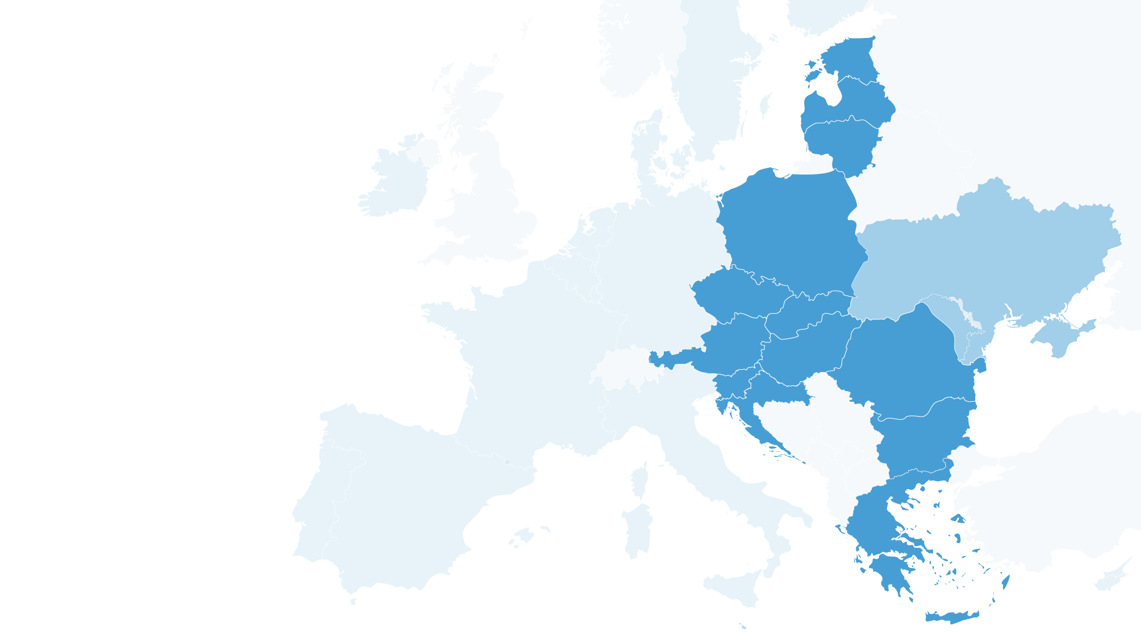
Three Seas Initative Investment Fund
Basic information

Slide 2
Three Seas Initative Investment Fund
The Three Seas Initiative Investment Fund (3SIIF) represents a commercial investment entity officially established in Luxembourg on May 29, 2019.
This fund is dedicated to investing in enterprises situated in Central Europe, with a primary focus on three key sectors:
transportation,
energy,
digitalization.
Source: J. Wilczek, A. Rudowski, Fundusz Trójmorza. W stronę instytucjonalizacji Inicjatywy?, Collegium Interethnicum, https://trojmorze.isppan.waw.pl/fundusz-inwestycyjny-inicjatywy-trojmorza/

Slide 3
Three Seas Initative Investment Fund
As of 2024, the total funds amassed equate to PLN 928 milion;
The investors consist of 9 development institutions representing 9 diffrent 3SI states;
Amber Fund Management Ltd from the UK serving as the sole investment advisor to the Fund;
The Fund has executed 5 investments, selected based on market criteria, which target companies operating within the three pillars of the Three Seas Initiative: transport, energy, and digitalization;
The Fund prioritizes investments in projects that have the potential to yield profits.
Investments are located across territories of at least two participating states;

Slide 4
3SIIF investors
State | Development institution | Allocated funds (millions euro) | Percentage
Poland | Bank Gospodarstwa Krajowego | 750 | 84%
Slovenia | Slovenska izvozna in razvojna banka | 23 | 3%
Hungary | EXIM | 20 | 2%
Croatia | Hrvatska banka za obnovu i razvitak | 20 | 2%
Estonia | Rahandusministeerium | 20 | 2%
Lithuania | Investicijų ir verslo garantijos | 20 | 2%
Romania | EximBank | 20 | 2%
Bulgaria | Bulgarian Development Bank | 20 | 2%
Latvia | Altum | 20 | 2%
The United States International Development Finance Corporation, during the Bucharest summit in 2023, concluded an investment in 3SIIF, in the form of a debt instrument, totaling USD 300 million.
Source: https://www.gov.pl/web/dyplomacja/inicjatywa-trojmorza

Slide 5
Completed investments
During her address at the meeting of the Foreign Affairs Committee in July 2023, Beata Daszyńska-Muzyczka, the President of BGK at the time, disclosed that a total of PLN 928 million had been amassed by 2023, along with the successful execution of five investments. In 2023, the Fund completed its capital-raising activities from investors.
Source: Proceedings of the meeting of the Foreign Affairs Committee, https://orka.sejm.gov.pl/zapisy9.nsf/0/A7CA90132486654EC1258A0000477E7F/%24File/0398509.pdf. See:: J. Wilczek, A. Rudowski, Fundusz Trójmorza. W stronę instytucjonalizacji Inicjatywy?, Collegium Interethnicum, https://trojmorze.isppan.waw.pl/fundusz-inwestycyjny-inicjatywy-trojmorza/

Slide 6
Investment in Cargounit
Cargounit leases a fleet of 180 locomotives, primarily operating in Central Europe.
In 2020, 3SIIF acquired 100% of the company's shares, providing stable financing and contributing to the formulation of its development strategy.
For railway carriers, leasing locomotives is often a more flexible and cost-effective alternative to purchasing.
The acquisition of Cargounit by 3SIIF presents enhanced opportunities for railway development in 3SI countries.
Website: https://cargounit.eu/
See also: https://www.amberinfrastructure.com/sectors/case-studies/cargounit
Source: https://3seas.eu/media/news/three-seas-fund-agrees-its-first-investment

Slide 7
Investment in Greenergy Data Centers
Greenergy is currently in the process of establishing a network of energy-efficient data centers in the Three Seas Initiative states, which will be powered by renewable energy sources.
The inaugural data center commenced operations in Estonia in 2022 and is catering to the markets of the Baltic countries.
Greenergy has outlined plans for future projects in Latvia and Lithuania. The 3SI region, comprising countries with burgeoning requirements for data processing and storage due to the rapid pace of digitalization, presents a promising opportunity for such initiatives.
In 2020, the Three Seas Initiative Investment Fund acquired a controlling interest in Greenergy.
Website: https://www.greenergydatacenters.com/
See also: https://www.amberinfrastructure.com/sectors/case-studies/greenergy-data-centers
Source: https://3seas.eu/media/news/second-investment-by-three-seas-fund-announced

Slide 8
Investment in Enery Development GmbH
The Fund has recently obtained a share in Enery Development, a company that owns and operates solar power facilities located in three countries participating in the Three Seas Initiative, namely Bulgaria, Romania, and Austria.
Enery Development specializes in the acquisition, development, construction, and management of renewable energy plants in Central Europe."
Website: https://enery.energy/en/home/
See also: https://www.amberinfrastructure.com/sectors/case-studies/enery
Source: https://3seas.eu/media/news/third-investment-by-three-seas-fund-announced

Slide 9
Investment in BMF Port Burgas
BMF Port Burgas, situated on the Black Sea in Bulgaria, has recently seen a minority stake in its port operator BMF acquired by 3SIIF in 2022. This acquisition has provided the port with secure financing, fostering its development.
As a result, BMF Port Burgas stands to enhance the connections of the 3SI region with Central Asia and the Middle East, offering significant potential for growth and development in the region.
BMF Port Burgas logo
Website: https://3seas.eu/media/news/3siif-makes-its-first-investment-in-the-port-sector
See also: https://www.amberinfrastructure.com/sectors/case-studies/bmf-port-burgas
Source: https://www.amberinfrastructure.com/news/press-releases/2021/3siif-makes-its-first-investment-in-the-port-sector/

Slide 10
Investment in R. Power
In February 2023, the Fund secured a minority interest in R. Power, the leading photovoltaic company in Poland. Beyond Poland, the company actively develops photovoltaic ventures in Portugal, Italy, and Spain.
R. Power engages in the complete value chain of the photovoltaic market, encompassing the development of power plant projects, their construction, as well as the provision of management, maintenance, and operational services for photovoltaic power plants.
Website: https://cargounit.eu/https://rpower.solar/
See also: https://www.amberinfrastructure.com/sectors/case-studies/rpower-renewables

Slide 11
New investments – Bucharest 2023
Joint Declaration of the Eighth Summit of the Three Seas Initiative (Bucharest, 6-7 September 2023)
We salute the dynamic evolution of the Three Seas Initiative Investment Fund, which, at exceptional speed, three years after becoming operational has invested in energy, digital and transportation sectors into the Three Seas region, proving its capability to develop projects that contribute to increase of renewable capacity in the regional energy mix, enhance the security and independence of energy supply, as well as digital and transportation interconnectivity in the Three Seas region. The 3SIIF has so far supported 5 projects, of approximate value of EUR 6 billion, with up to 2 more projects soon to be revealed.
Source: https://3si.politic.edu.pl/joint-declaration-of-the-eighth-summit-of-the-three-seas-initiative-bucharest-6-7-september-2023/

Slide 12
New instruments – Vilnius 2024
Joint Declaration of the Ninth Summit of the Three Seas Initiative (Vilnius, 11 April 2024)
We commend the results achieved by the current 3SI Investment Fund and its contribution to facilitating economic growth and connectivity through strategic investments. We also welcome the establishment of a dedicated working group tasked with laying the groundwork for the successor to the existing 3SIIF.
The continuation of this initiative underscores our commitment to fostering infrastructure development and sustainable economic prosperity across the Three Seas region. Furthermore, we note the progress made in developing the 3SI Innovation Fund in collaboration with the European Investment Fund, with a perspective to provide capital to startups and scale–ups across the Three Seas region, bridging the funding gap in financing innovations, thus increasing competitiveness of Three Seas businesses. With progress already underway, we are confident that these initiatives will further strengthen our collective efforts in unlocking the potential of the 3SI.
Source: https://3si.politic.edu.pl/joint-declaration-of-the-ninth-summit-of-the-three-seas-initiative/

Slide 13
The future of the 3SI Investment Fund
The funds in the current Fund have been distributed.
The 3SI countries are considering launching another fund on similar terms as the current one (see Joint Declaration of the Nineth Summit of the Three Seas Initiative in Vilnius, 2024).
Source: Proceedings of the meeting of the Foreign Affairs Committee, https://orka.sejm.gov.pl/zapisy9.nsf/0/A7CA90132486654EC1258A0000477E7F/%24File/0398509.pdf.

Slide 14
What it is and what it is not 3SI Investment Fund?
NO
An infrastructure fund is in place to finance the development of regional road, rail, and digitalization networks.
Backed by the shareholders of all the countries participating in the Three Seas Initiative.
The development institutions of the participating nations have equally contributed funds to this endeavor.
This fund aims to invest in enterprises of all types within the region.
YES
The Fund has been established with contributions from 9 development institutions across 3SI states.
The Fund focuses on investing in companies within the energy, transport, and digital sectors.
Investments are carefully chosen based on market-based criteria.

Slide 15
Thank you for your attention
The presentation was prepared by:
Jędrzej Błaszczak – Three Seas Initiative Research Center project
In cooperation with:
prof. Agnieszka Orzelska-Stączek - leader of the Three Seas Initiative Research Center project;
dr. Konrad Popławski - Center for Eastern Studies;
With support of the Three Seas Initative Research Center team

